Slide 1
Virtual Memory Management
Hamid R. Zarandi
h_zarandi@aut.ac.ir

Slide 2
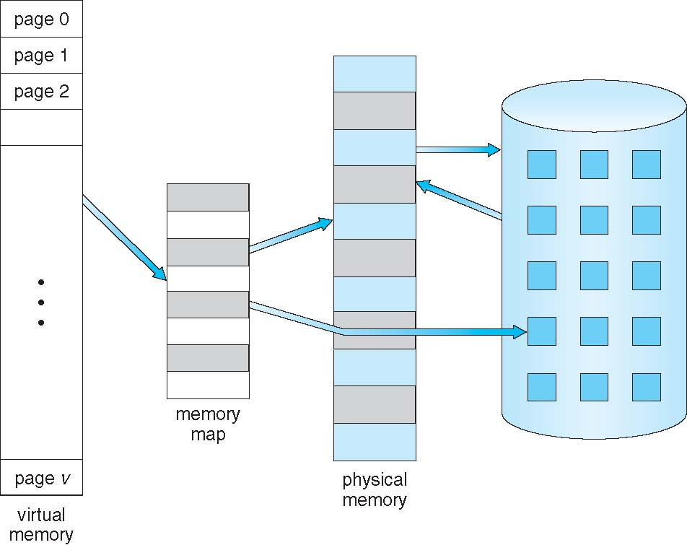
Virtual memory > physical memory

Slide 3
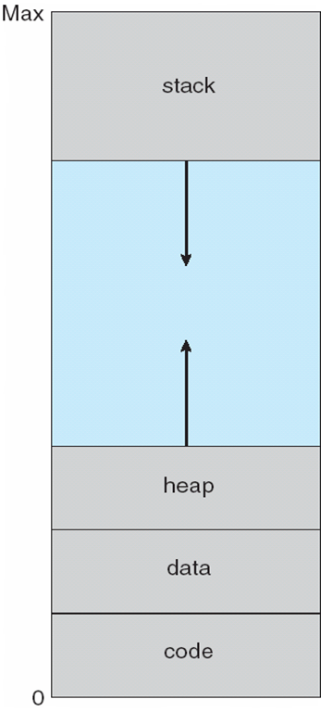
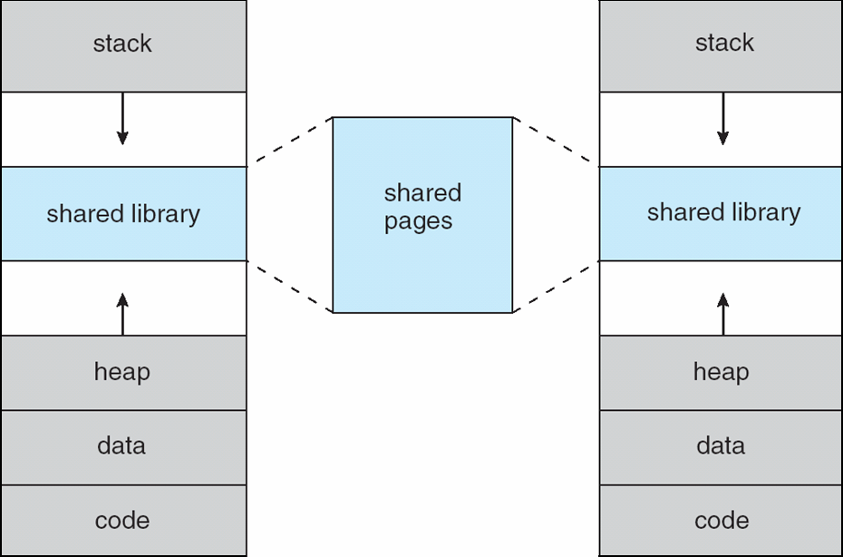
Virtual address space
Code, date, heap, stack
Possible of Sparse addresses
Shared library usage

Slide 4
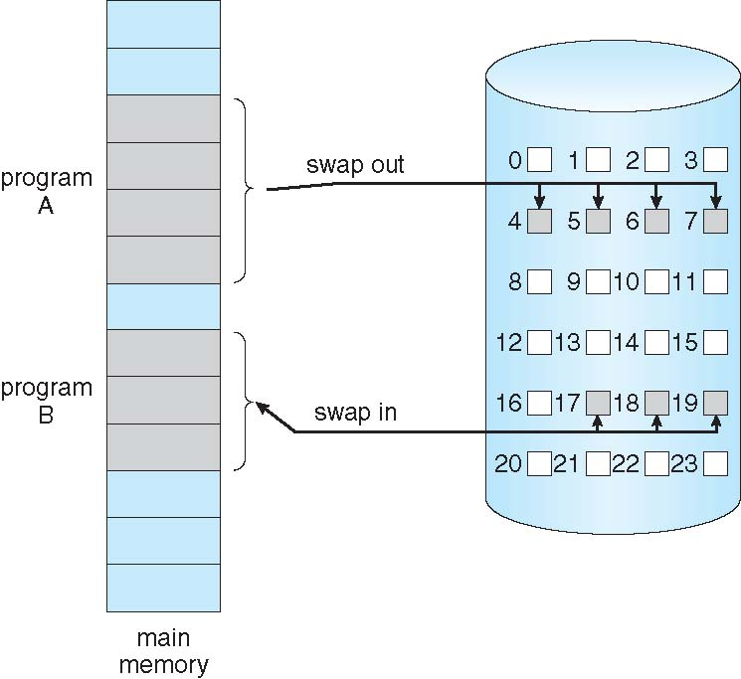
Demand paging
Why demand paging?
Less memory needed
Faster response
Better CPU utilization
Lazy swapper – never swaps a page into memory unless page will be needed
Swapper that deals with pages is a pager
Swapper is different from Pager

Slide 5
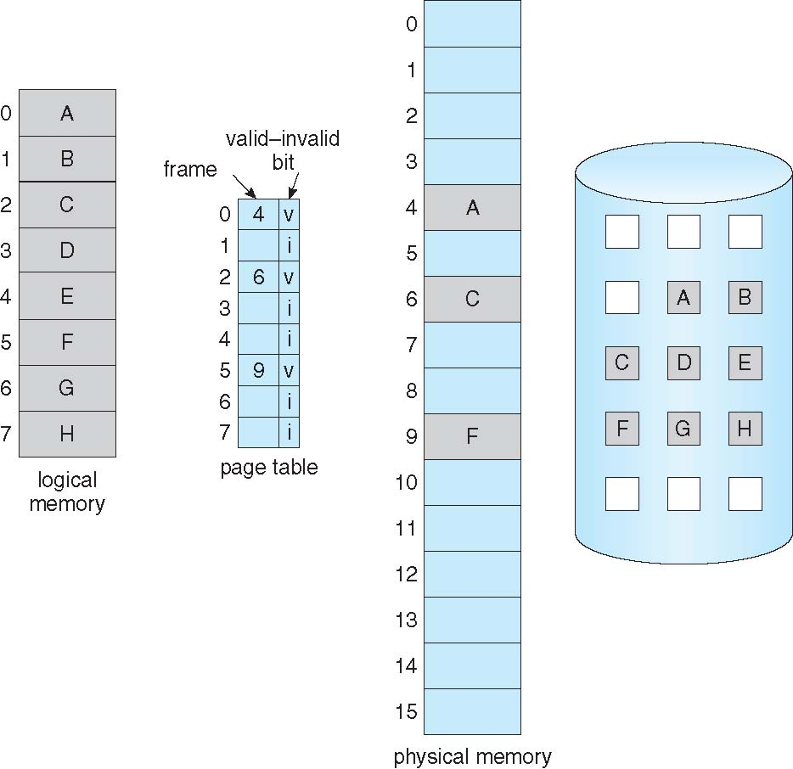
Demand paging implementation
Help of valid-invalid bit

Slide 6
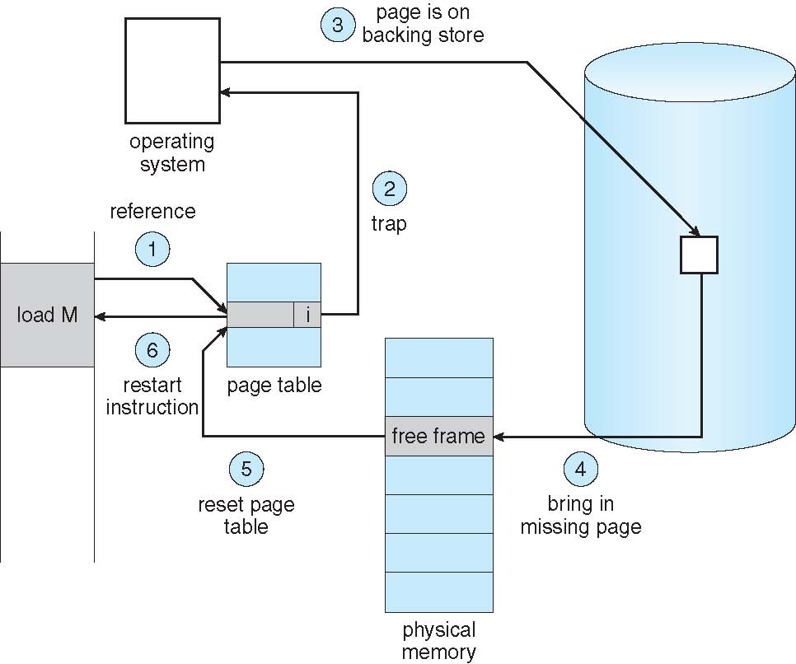
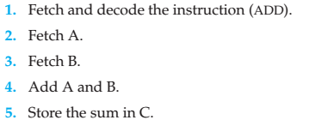
Page fault, its handler
If there is a reference to a page, first reference to that page will trap to operating system: page fault
Extreme case – start process with no pages in memory (Pure demand paging)
OS sets instruction pointer to first instruction of process, non-memory-resident -> page fault
What happens for an instruction with page fault?

Slide 7
Stages in demand paging
Trap to the operating system
Save the user registers and process state
Determine that the interrupt was a page fault
Check that the page reference was legal and determine the location of the page on the disk
Issue a read from the disk to a free frame:
Wait in a queue for this device until the read request is serviced
Wait for the device seek and/or latency time
Begin the transfer of the page to a free frame
While waiting, allocate the CPU to some other user
Receive an interrupt from the disk I/O subsystem (I/O completed)
Save the registers and process state for the other user
Determine that the interrupt was from the disk
Correct the page table and other tables to show page is now in memory
Wait for the CPU to be allocated to this process again
Restore the user registers, process state, and new page table, and then resume the interrupted instruction

Slide 8
Performance of demand paging
Three major activities
Service the interrupt – careful coding means just several hundred instructions needed
Read the page – lots of time
Restart the process – again just a small amount of time
Page Fault Rate 0 ≤ p ≤ 1
if p = 0 no page faults
if p = 1, every reference is a fault
Effective Access Time (EAT)
EAT = (1 – p) x memory access
+ p (page fault overhead
+ swap page out
+ swap page in )

Slide 9
Demand paging example
Memory access time = 200 nanoseconds
Average page-fault service time = 8 milliseconds
EAT = (1 – p) x 200 + p (8 milliseconds)
= (1 – p) x 200 + p x 8,000,000
= 200 + p x 7,999,800
If one access out of 1,000 causes a page fault, then
EAT = 8.2 microseconds.
This is a slowdown by a factor of 40!!
If want performance degradation < 10 percent
220 > 200 + 7,999,800 x p 20 > 7,999,800 x p
p < .0000025
< one page fault in every 400,000 memory accesses

Slide 10
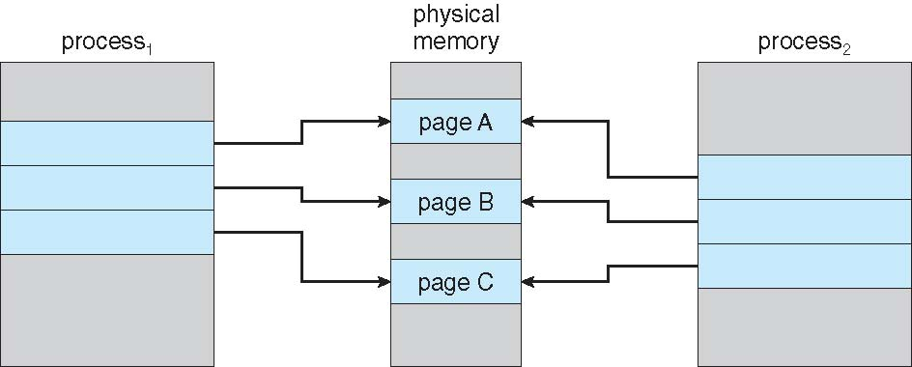
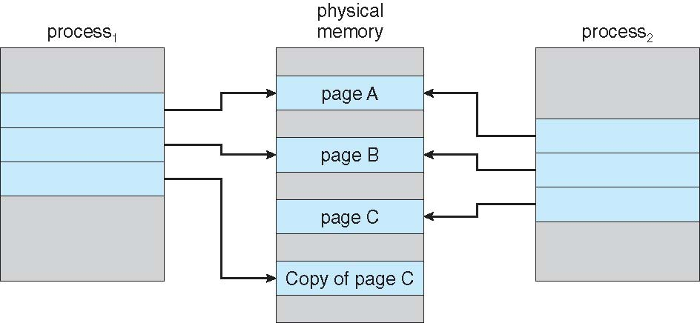
Copy-on-Write
Copy-on-Write (COW) allows both parent and child processes to initially share the same pages in memory

Slide 11
Page replacement

Slide 12
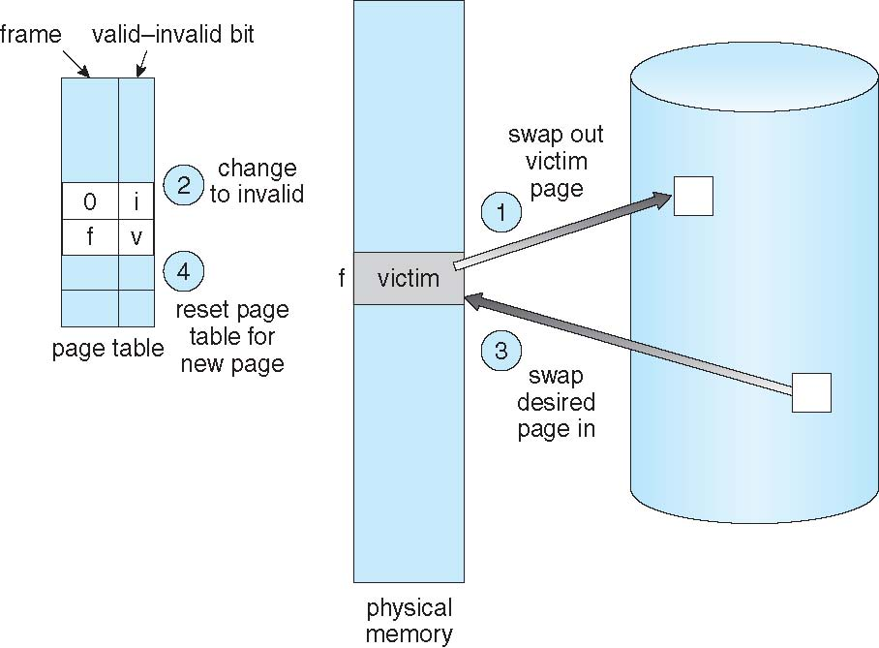
Page replacement

Slide 13
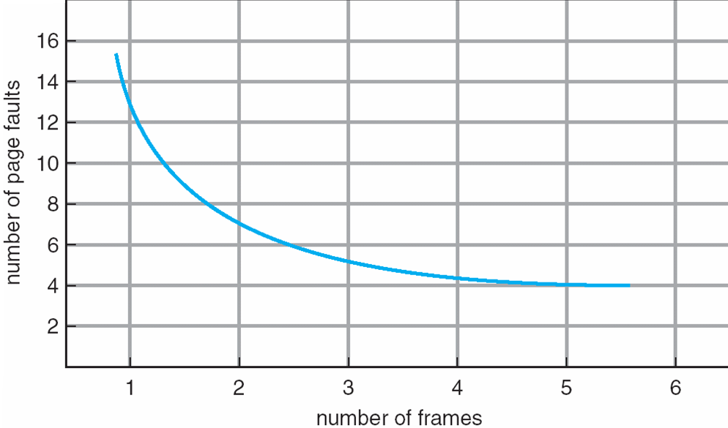
Page faults vs. # of frames

Slide 14
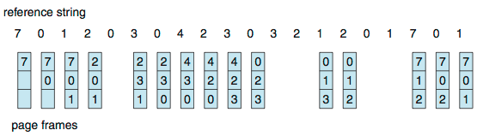
First-In-First-Out (FIFO) algorithm
Problems
Much miss rate (high page fault)
FIFO anomaly (Belady’s anomaly)
Check 1,2,3,4,1,2,5,1,2,3,4,5
8 page faults for 3-page mem!
10 page faults for 4-page mem!

Slide 15
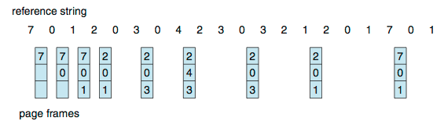
Optimal algorithm
Replace page that will not be used for longest period of time
Problems
Who is aware of future?
Used only for comparison other algorithms

Slide 16
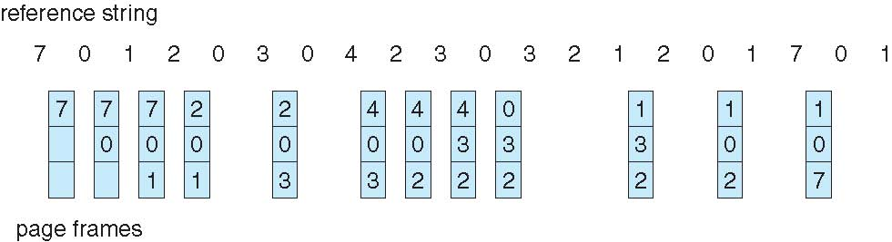
Least Recently Used (LRU)
Better than FIFO but worse than OPT
Two possible implementations
Counter-based
Stack-based
LRU and OPT are cases of stack algorithms that don’t have Belady’s Anomaly

Slide 17
Second-Chance (clock) algorithm = NRU

Slide 18
LFU, MFU
Keep a counter of the number of references that have been made to each page
Not common
Least Frequently Used (LFU) Algorithm: replaces page with smallest count
Most Frequently Used (MFU) Algorithm: based on the argument that the page with the smallest count was probably just brought in and has yet to be used

Slide 19
Global vs. Local allocation
Global replacement – process selects a replacement frame from the set of all frames; one process can take a frame from another
But then process execution time can vary greatly
But greater throughput so more common
Local replacement – each process selects from only its own set of allocated frames
More consistent per-process performance
But possibly underutilized memory
Allocation algorithms
Equal allocation
Proportional allocation
Proportional to size of program

Slide 20
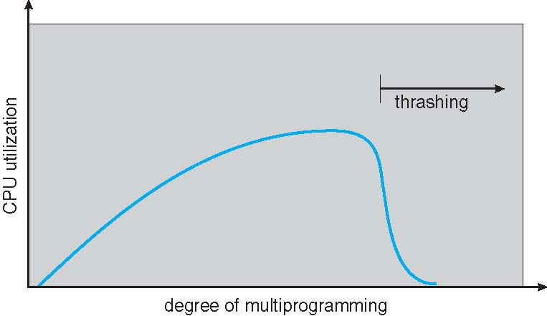
Thrashing (نامتعادل، کوبیدگی)

Slide 21
Thrashing
If a process does not have “enough” pages, the page-fault rate is very high
Page fault to get page
Replace existing frame
But quickly need replaced frame back
This leads to:
Low CPU utilization
Operating system thinking that it needs to increase the degree of multiprogramming
Another process added to the system
Thrashing ≡ a process is busy swapping pages in and out

Slide 22
Demand paging vs. thrashing
Why does demand paging work?
Locality model
Process migrates from one locality to another
Localities may overlap
Why does thrashing occur?
Σ size of locality > total memory size
Limit effects by using local or priority page replacement

Slide 23
Solutions for Thrashing

Slide 24
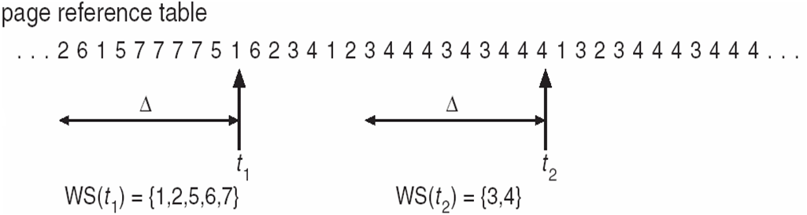
1) Working-set model
Δ ≡ working-set window ≡ a fixed number of page references Example: 10,000 instructions
WSS_{i} (working set of Process P_{i}) = total number of pages referenced in the most recent Δ (varies in time)
if Δ too small will not encompass entire locality
if Δ too large will encompass several localities
if Δ = ∞ ⇒ will encompass entire program
D = Σ WSS_{i} ≡ total demand frames
Approximation of locality
if D > m ⇒ Thrashing
Policy: if D > m then
suspend or
swap out one of the processes

Slide 25
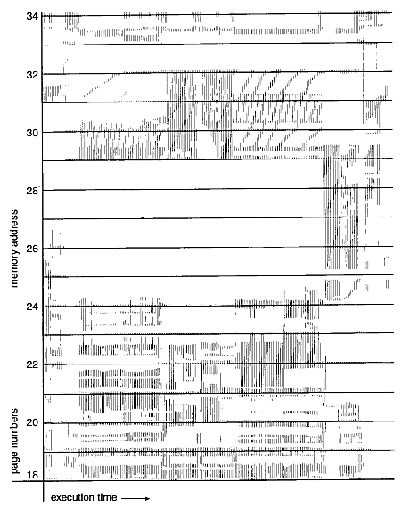
Working set of a program

Slide 26
Keeping track of the working set
Approximate with interval timer + a reference bit
Example: Δ = 10,000
Timer interrupts after every 5000 time units
Keep in memory 2 bits for each page
Whenever a timer interrupts copy and sets the values of all reference bits to 0
If one of the bits in memory = 1 ⇒ page in working set
Why is this not completely accurate?
Improvement = 10 bits and interrupt every 1000 time units

Slide 27
2) Page-fault frequency
More direct approach than WSS
Establish “acceptable” page-fault frequency (PFF) rate and use local replacement policy
If actual rate too low, process loses frame
If actual rate too high, process gains frame

Slide 28
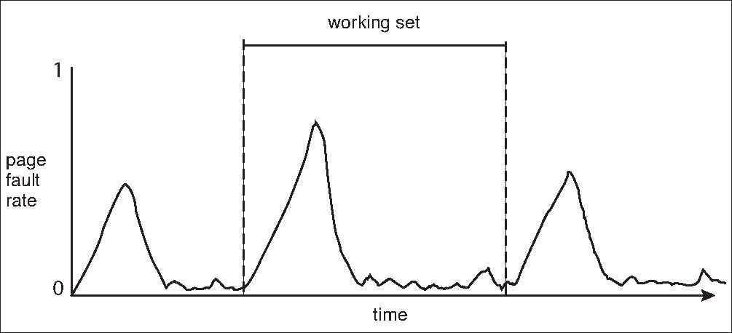
Working sets and Page fault rates
Direct relationship between working set of a process and its page-fault rate
Working set changes over time
Peaks and valleys over time

Slide 29
Memory mapped files, IOs

Slide 30
Memory-mapped files
Memory-mapped file I/O allows file I/O to be treated as routine memory access by mapping a disk block to a page in memory
A file is initially read using demand paging
A page-sized portion of the file is read from the file system into a physical page
Subsequent reads/writes to/from the file are treated as ordinary memory accesses

Slide 31
Memory mapped files
Shared Memory via Memory-Mapped I/O
Some OSes uses memory mapped files for standard I/O

Slide 32
Kernel memory allocation & Virtual memory allocation

Slide 33
1) Buddy system allocator
Allocates memory from fixed-size segment consisting of physically-contiguous pages
Memory allocated using power-of-2 allocator
Satisfies requests in units sized as power of 2
Request rounded up to next highest power of 2
When smaller allocation needed than is available, current chunk split into two buddies of next-lower power of 2
Continue until appropriate sized chunk available
For example, assume 256KB chunk available, kernel requests 21KB
Split into A_{L} _{and} A_{R} of 128KB each
One further divided into B_{L} and B_{R} of 64KB
One further into C_{L} and C_{R} of 32KB each – one used to satisfy request
Advantage – quickly coalesce unused chunks into larger chunk
Disadvantage - fragmentation

Slide 34
Buddy system allocator scheme

Slide 35
2) Slab allocator
Alternate strategy
Slab is one or more physically contiguous pages
Cache consists of one or more slabs
Single cache for each unique kernel data structure
Each cache filled with objects – instantiations of the data structure
When cache created, filled with objects marked as free
When structures stored, objects marked as used
If slab is full of used objects, next object allocated from empty slab
If no empty slabs, new slab allocated
Benefits include no fragmentation, fast memory request satisfaction

Slide 36
Slab allocation scheme

Slide 37
Some important points

Slide 38
I) Prepaging
Prepaging
To reduce the large number of page faults that occurs at process startup
Prepage all or some of the pages a process will need, before they are referenced
But if prepaged pages are unused, I/O and memory was wasted
Assume s pages are prepaged and α of the pages is used
Is cost of s * α save pages faults > or < than the cost of prepaging s * (1- α) unnecessary pages?
α near zero ⇒ prepaging loses

Slide 39
II) Page Size
Sometimes OS designers have a choice
Especially if running on custom-built CPU
Page size selection must take into consideration:
Fragmentation
Page table size
Resolution
I/O overhead
Number of page faults
Locality
TLB size and effectiveness
Always power of 2, usually in the range 2¹² (4,096 bytes) to 2²² (4,194,304 bytes)
On average, growing over time

Slide 40
III) TLB reach
TLB Reach - The amount of memory accessible from the TLB
TLB Reach = (TLB Size) X (Page Size)
Ideally, the working set of each process is stored in the TLB
Otherwise there is a high degree of page faults
Increase the Page Size
This may lead to an increase in fragmentation as not all applications require a large page size
Provide Multiple Page Sizes
This allows applications that require larger page sizes the opportunity to use them without an increase in fragmentation

Slide 41
IV) Program structure
int[128,128] data;
Each row is stored in one page
Program 1
for (j = 0; j <128; j++) for (i = 0; i < 128; i++) data[i,j] = 0;
128 x 128 = 16,384 page faults
Program 2
for (i = 0; i < 128; i++) for (j = 0; j < 128; j++) data[i,j] = 0;
128 page faults

Slide 42
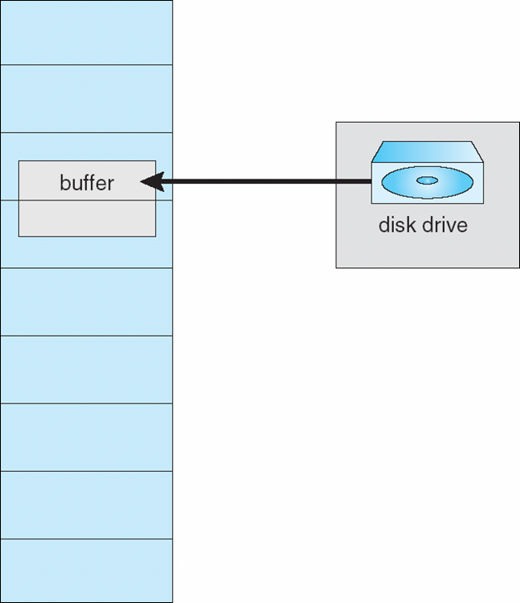
V) IO lock
I/O Interlock – Pages must sometimes be locked into memory
Consider I/O - Pages that are used for copying a file from a device must be locked from being selected for eviction by a page replacement algorithm
Pinning of pages to lock into memory

Slide 43

Questions?

